Slide 1
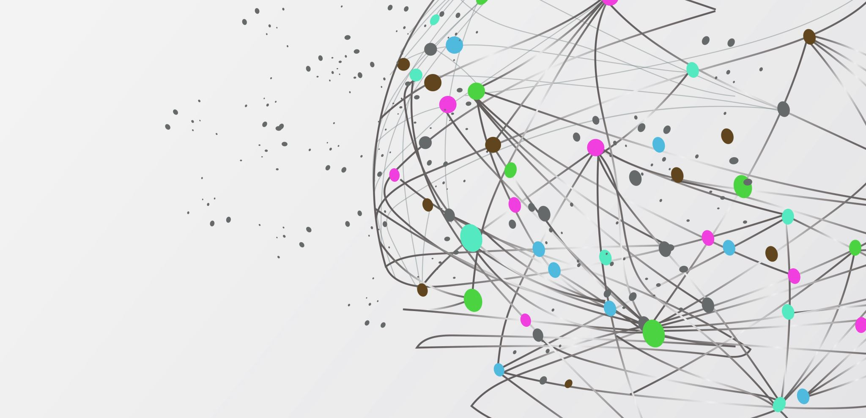
Data Communication and Computer Networks(CPE314)

Slide 2


Major Dc components
1) Message: Information to be communicated: text, numbers, pictures, audio, video.
2) Senders: devices that transmits the data messages: computers, telephones, TV stations, cameras, etc.
3) Receivers: devices that receives the data messages: computers, telephones, TV sets, etc.
4) Transmission medium: Physical links that carries the communicated data, TP, coaxial, fibers, radio waves, etc
5) Protocol for DC: Set of rules that govern DC, syntax and semantics.
Data are text, Numbers, Images, Audio, and video.

Slide 3
DATA FlOW
Data flow between communication devices as follows:
a) Simplex (one way only).
b) Half Duplex (H/D) (Bidirectional on one links).
c) Full Duplex (F/D) (Bidirectional on two links).

Slide 4
Networks
Set of nodes connected via physical links for the purpose of:
1) Distributing Processing: dividing a large task over a network of computers.
2) Sharing Data vs. centralization: shared access of data-banks (and other resources) among network of computers.
3) Security and robustness: distributed computers approach is for more security and reliability/dependability.

Slide 5
Physical structure
1) Point to Point: (P2P)
Dedicated link to be utilized only by end devices.
2) Multipoint (Multidrop): Many end devices share the link capacity.

Slide 6

Physical topologies

Slide 7
Mesh topology
Each device has dedicated point-to-point link to other devices. Fully connected mesh will have [n( n-1)/ 2] F/D links:
Where n = number of nodes
Pros: Fast communication (cable propagation delay), Robust (faulty node/link does not affect other nodes) and Privacy (Security-- direct/private links). Easy to fault detect/isolate.
Cons: Cabling Space, fan-out ports, and $cost$.

Slide 8
Star toplogy
Devices are connected Point to Point to a central “Hub” (Controller Exchanger).
Pros: Less links and ports per node, two hops delay only-- source to Hub and Hub to destination delays. Cost of the Hub installation/operation. Easy to maintain when nodes added/dropped nodes.
Cons: Not so robust (vulnerable center of control- The Hub!), more physical cables one per each node compared to the Bus!

Slide 9
Bus topology
Multipoint link as “backbone” for a network where devices have drop line to tap into the bus
Pros: Less Cabling, one hop (source-destination cable) delay.
Cons: Scalability is limited and cable length dependent, which limit number of nodes on the bus due to signal power loss (attenuation) with distance, not so robust. Difficult fault isolation!

Slide 10
Ring topology
Each station connects Point to Point with only two other stations (on its left and right), stations are connected to the ring via a Repeater (its exact function depends on the higher layer protocol, e.g., MAC).
Pros : Easy installation, better fault isolation (a dead node will be shorted and the ring remains functioning) and robustness (all nodes are still connected even when the ring breaks with one physical cable cut).
Cons: n/2 hops communication delay on average, vulnerable to cuts.

Slide 11
hybrid
Pros: Better domain separation management (domain security and speed), one hop delay (cable propagation delay).
Cons: Better robustness than the “star”, but still vulnerable to Hub failure!

Slide 12
Pizza topology
“star” inside a “ ring”
Pros: Better robustness (why?), still low cost, Delay is 1 hop to neighboring left/right nodes, or 2 hops to other nodes.
Cons: The $cost$ of adding more cabling than the Ring and Star, individually.

Slide 13
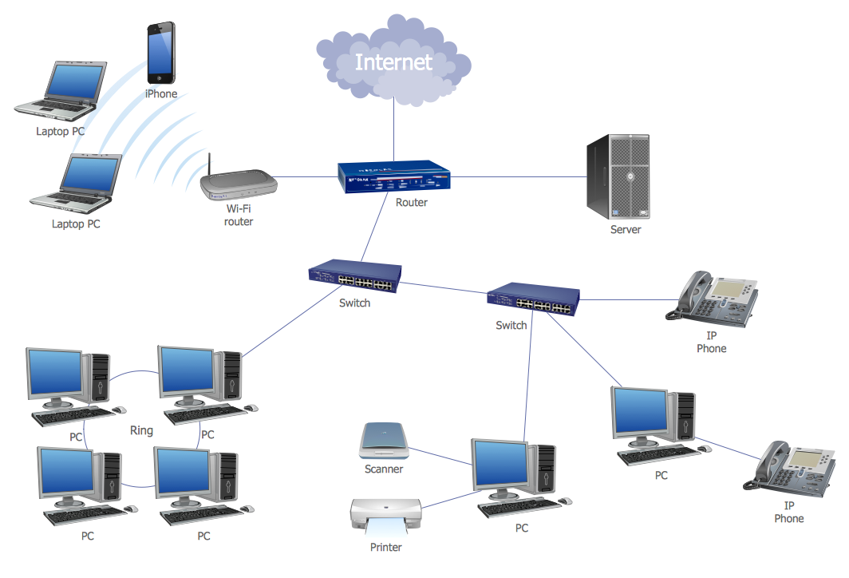
Categories of networks
Local Area Networks (LAN): Few Kilometers
Connects devices (PC’s, printers, servers.) within the same room, building, company, and campus.
Topologies most used are bus, ring, and star.

Slide 14
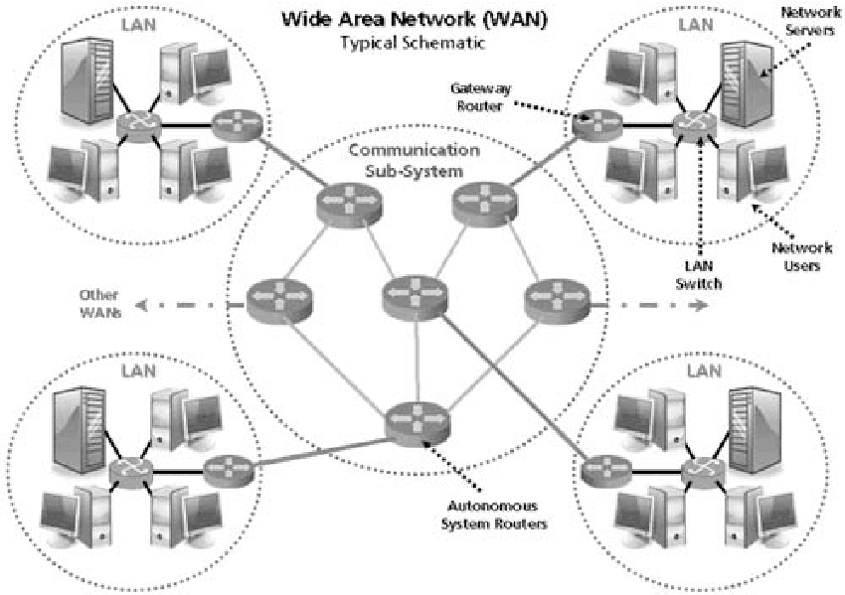
Wide area network(WAN) connecting Lans

Slide 15
















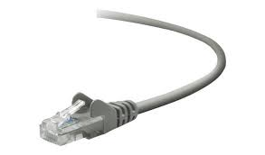
The Internet: a “nuts and bolts” view
Billions of connected computing devices:
hosts = end systems
running network apps at Internet’s “edge”
mobile network
national or global ISP
Packet switches: forward packets (chunks of data)
routers, switches
local or regional ISP
Internet
Communication links
fiber, copper, radio, satellite
transmission rate: bandwidth
home network
content
provider
network
datacenter
network
Networks
collection of devices, routers, links: managed by an organization
enterprise
network

Slide 16

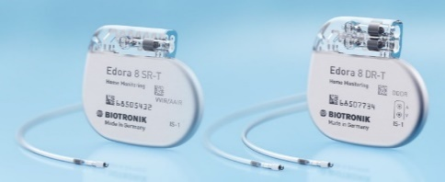
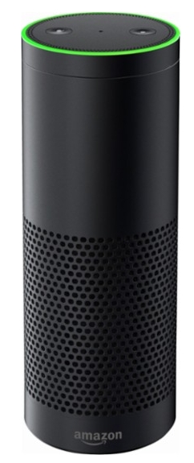

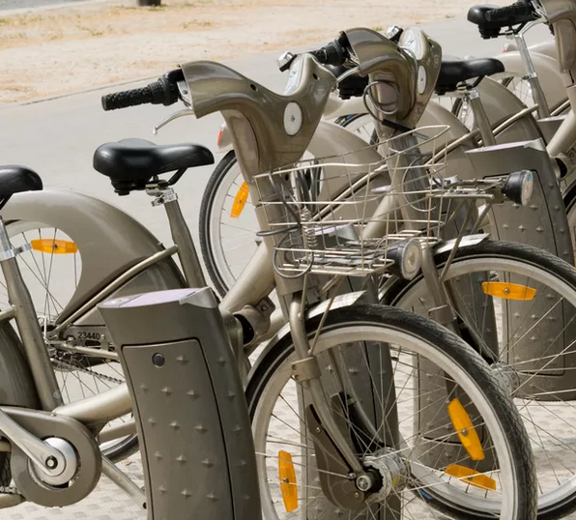

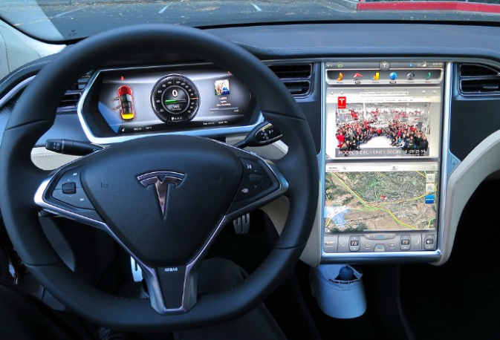

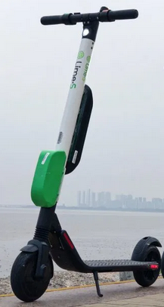
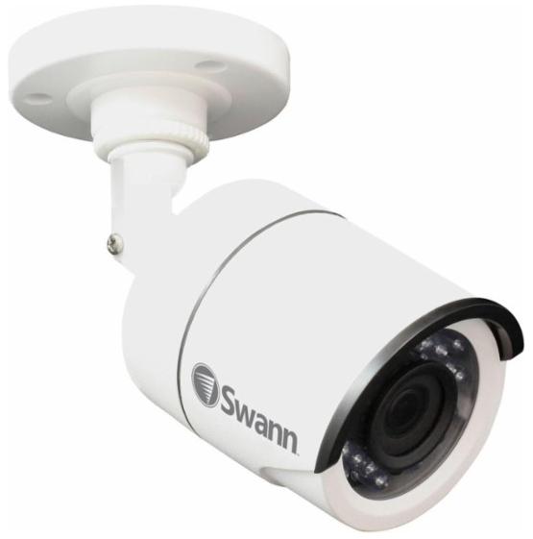
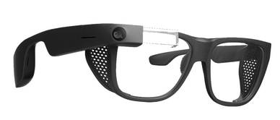

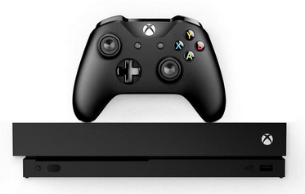

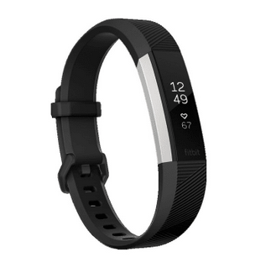

“Fun” Internet-connected devices
Tweet-a-watt:
monitor energy use
bikes
Pacemaker & Monitor
Amazon Echo
Web-enabled toaster +
weather forecaster
IP picture frame
Internet
refrigerator
Slingbox: remote
control cable TV
cars
Security Camera
AR devices
sensorized,
bed
mattress
scooters
Others?
Gaming devices
Internet phones
Fitbit

Slide 17
The Internet: a “nuts and bolts” view
mobile network
4G
Internet: “network of networks”
Interconnected ISPs
national or global ISP
protocols are everywhere
control sending, receiving of messages
e.g., HTTP (Web), streaming video, Skype, TCP, IP, WiFi, 4G, Ethernet
IP
Streaming
video
Skype
local or regional ISP
home network
content
provider
network
Internet standards
RFC: Request for Comments
IETF: Internet Engineering Task Force
HTTP
datacenter
network
Ethernet
TCP
enterprise
network
WiFi

Slide 18
The Internet: a “services” view
Infrastructure that provides services to applications:
Web, streaming video, multimedia teleconferencing, email, games, e-commerce, social media, inter-connected appliances, …
mobile network
national or global ISP
Streaming
video
Skype
local or regional ISP
provides programming interface to distributed applications:
“hooks” allowing sending/receiving apps to “connect” to, use Internet transport service
provides service options, analogous to postal service
home network
content
provider
network
HTTP
datacenter
network
enterprise
network

